Slide 1
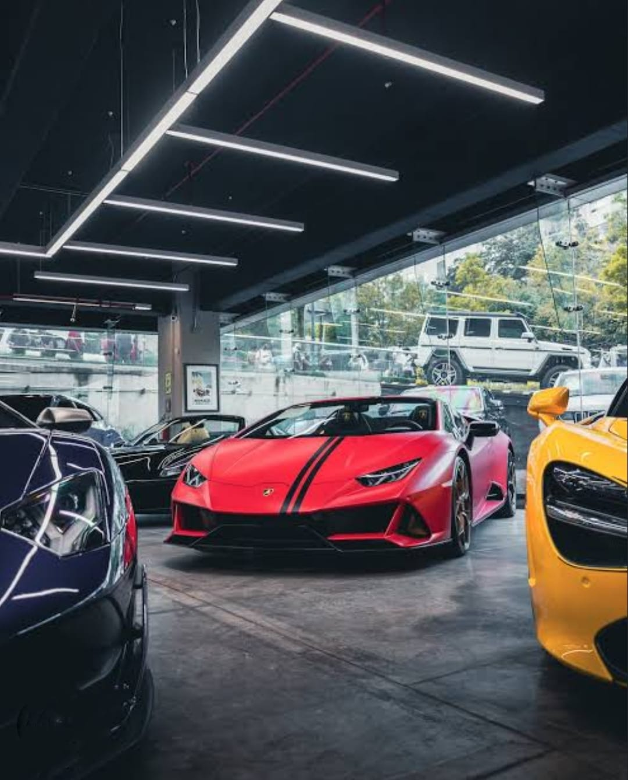
ONLINE CAR SHOWROOM SYSTEM
LRG GOVERNMENT ARTS COLLEGE FOR WOMEN
SUBMITTED BY :SIVADHARSHINI R
CLASS : B.SC COMPUTER SCIENCE 3RD YEAR
SUBMITTED TO : Mrs. A. SANKARI MSC

Slide 2
OUTLINE
ABSTRACT
OBJECTIVES
SYSTEM SPECIFICATION
> HARDWARE SPECIFICATION
> SOFTWARE SPECIFICATION
EXISTING SYSTEM
> DRAWBACKS
PROPOSED SYSTEM
> FEATURES
MODULES
DATA FLOW DIAGRAM

Slide 3
ABSTRACT
The main aim of this car store project is to create a web-based application using PYTHON and MYSQL for an online car show room system that includes the customers to search for cars and order online and manage their online bookings
Online Car Store System is a website that allows a customer to search for various cars available at the store, segregate according to the price and model, Unique data of cars available, book the car online.
If they are accepting the product, manually can able to book and register via online. Also we can show the new model car are available or not in the car show room.

Slide 4
OBJECTIVE
This showroom system is designed for such owners and users who are interested in cars. This system keep track
and update of all the cars along with their each and every single detail. If someone is interested in buying a car, he/she
can contact the admin online and book his/her car and order that car.

Slide 5
HARDWARE SPECFICATION
Processor : P 4 700 GHz.
RAM : 4 GB RAM
Hard Disk Drive : 180 GB

Slide 6
SOFTWARE SPECIFICATION
Operating System : Windows 7/8/10
Front End : PYTHON
Back End : MYSQL

Slide 7
EXISTING SYSTEM
In the existing scenario, if someone has to buy a car or even interested in buying any car, then the person has to go to the showroom. Not only once, but every time, whenever he/she is looking for some fact, the only option left is to go to the showroom. This is very time consuming and very hectic as well. Sometimes, the buyer even lost interest because of this practice.
DRAWBACKS:
Its waste of time to visit the show room and collect the information about the car.
No way to find new model car.
Hard to manage the customer details

Slide 8
PROPOSED SYSTEM
The proposed Online car showroom system is very effective. If someone is interested in buying any car, then he/she can check all the information related to the car in the given portal. The proposed system also helps the buyer to check which cars are good for them, by showing them the past reviews about the car. The proposed system is so helpful and effective.
FEATURES:
Easy to manage the customer details
Save time & cost

Slide 9
Modules
Admin/User Login
Add Car Details
Car Booking
Booking Details

Slide 10
Modules
Admin/User Login
Admin or user either can using this application, user need to register before login. Which login credential they gave to create their account should use same credential to access this application. Otherwise, we won’t allow to enter into the login.
Add Cars Details
After admin login the admin register the new model cars details and photos as well. Once the photos have been uploaded these will be stored into the server. Which photos can be mapped into the view car models screen for the user.

Slide 11
Car Booking
The user can able to view the new model’s car’s in his home pages. If they are like to buy this car, they can able to register if the stocks are available. This will be notified to the car show room workers or managers.
View Booking details
Once the car details have been registered which details are viewing into the booking details screen. They can able to view the all the customer details and their favorite car details.
This will be giving cumulative report for the show room booking details

Slide 12

Data Flow Diagram
Level 0:

Slide 13
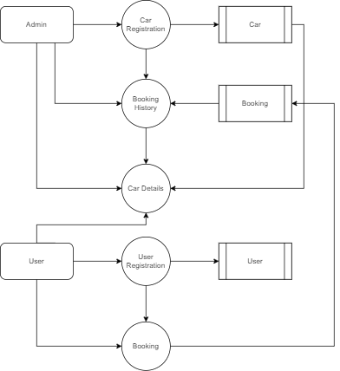
Level 1:

Slide 14
Thank You

